Slide 1
Wildfire Trends USA
DATA 230 - DATA VISUALIZATION TERM PROJECT

Slide 2
Professor: Dr. Andrew Bond
PREPARED BY:
NAME: HARIVARDHANA NAGA NAIDU POLIREDDI
ID: 017437238

Slide 3
Introduction
Humans have been working for decades to identify the causes of pollution and develop mitigation strategies. Certain elements of the environment are undoing decades' worth of advancements, despite knowledge and deliberate effort. One of them is air quality; over the years, wildfires' fierce rage has left a lasting scar on the ecosystems. Around the world, wildfires are frequent occurrences. Some of them, like the one in Australia in 2019–2020, have been extremely destructive, destroying millions of animals and plants in addition to nearly 2000 dwellings. Big fires that start in wild areas and later reach cities are a quiet but serious result of wildfires. Other effects disrupt the balance of nature. Knowing where wildfires come from and how they've happened in the past is crucial. This knowledge helps us create ways to stop them, focus on areas that are more likely to have fires and make the air cleaner for people's health.

Slide 4
Objectives
The goal of the project is to look at how often wildfires happen in the US over the years. This will help us see patterns and understand how to take steps to reduce the impact of wildfires better. Our primary goal is to dissect the causes of wildfires, the effects they have had on each state, and the steps that can be taken to lessen their frequency.

Slide 5
Goals
The goal is to determine the following:
1. Finding the States Most Affected by Wildfires: Examine the geolocation data to identify the states most impacted by wildfires.
2. Highest Temperature Recorded: Examine temperature characteristics to see which states have had the highest number of recorded temperature events in previous years.
3. What starts wildfires? enumerate the reasons why wildfires occur and determine which reason occurs most frequently.
4. Examine current employee practices in various states that mitigate the risk of wildfires to lower the likelihood of them occurring.
5. Time Analysis: Evaluate the behavior of wildfires on a yearly and monthly basis to raise public awareness of their occurrence.
6. Examine fire classes to find common fire class occurrences in wildfires.
7. Population Density and Wildfires: To analyze the spatial relationship between population density and wildfire occurrence. and spread, as well as the impact on human settlements.

Slide 6
Data Collection
Data Source:
KAGGLE
https://www.kaggle.com/datasets/4735dcf84228370db9a551c153b520cc6d9166aaeadffaf6205745c31c3585ae
Data Cleaning: EXCEL
PANDAS
Data Visualization:
TABLEAU

Slide 7
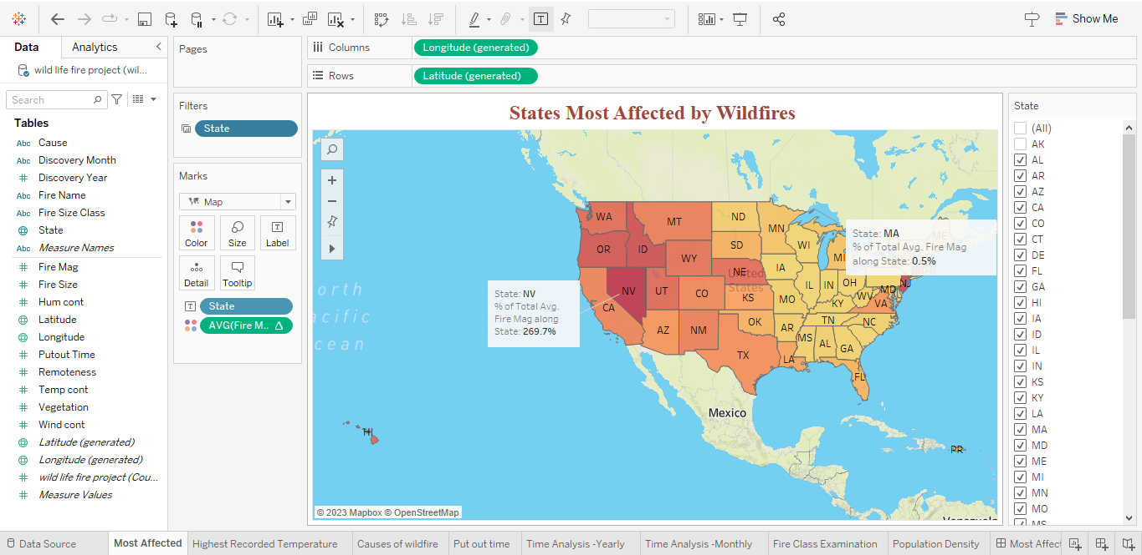
Stories Using Data
1. Title of Chart: States Most Affected by Wildfires
Explanation:
The objective is to investigate and determine which states have had the greatest fire intensity. With a color range legend, this graph shows the states of the United States about the intensity of the fire. The darker the color, the greater the fire magnitude, and the lighter the color, the lesser the fire magnitude.
Results:
Nevada is the state with the largest number of fires. The states that border it from the east are California, Idaho, and New Jersey.

Slide 8
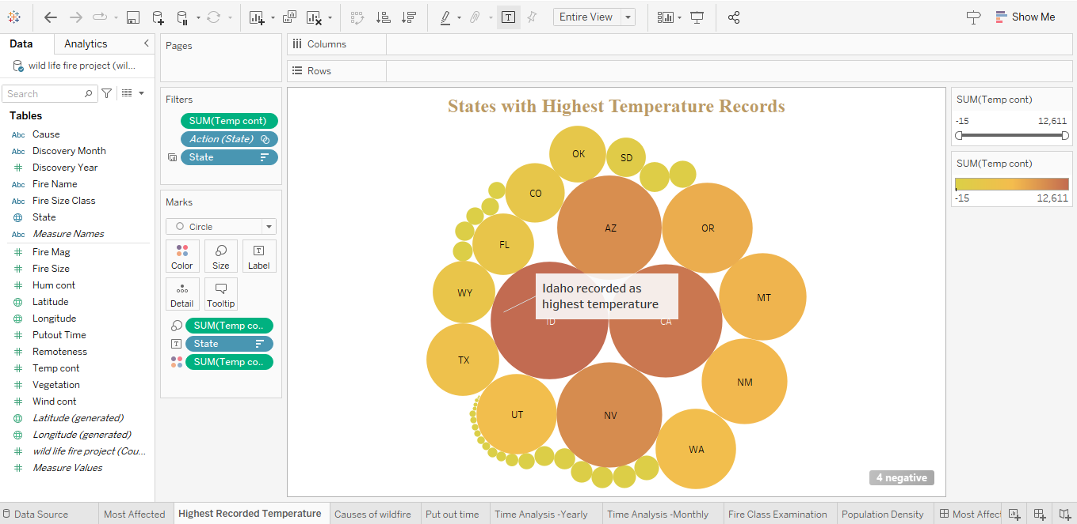
2. Title of Chart: States with Highest Temperature Records
Explanation: Examining the states with the highest temperatures ever recorded in previous years is the description. With temperature as the primary property, the graph displays the states of the United States in terms of size and color. Higher temperature values are seen in states with larger populations, whereas lower temperature values are found in states with smaller populations. Results: Based on the graph, the states with the highest reported temperatures were Nevada, Idaho, and California.

Slide 9
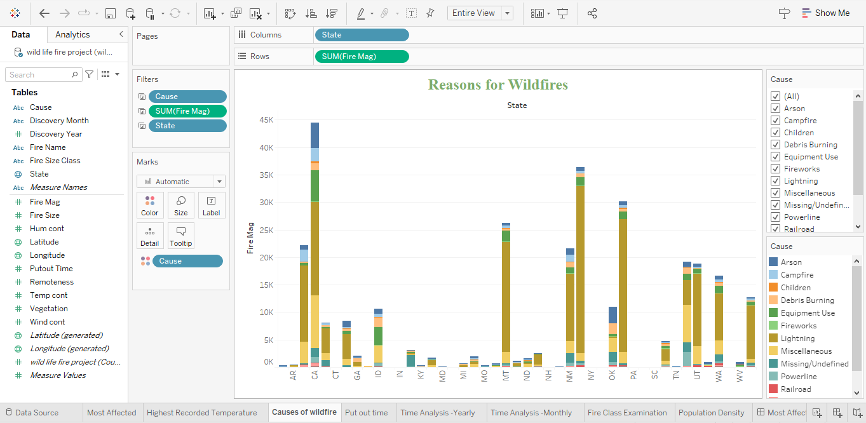
3. Title of Chart: Reasons for Wildfires
Explanation:
Analyze the list of wildfire causes and determine which states have the highest/most frequent wildfire occurrences. The wildfire causes are represented as a stacked bar graph, where each state's cause is indicated by a different hue.
Results:
Every state has found that lightning strikes are one of the most frequent causes of wildfires. According to this research, lightning is the primary cause of wildfires.

Slide 10
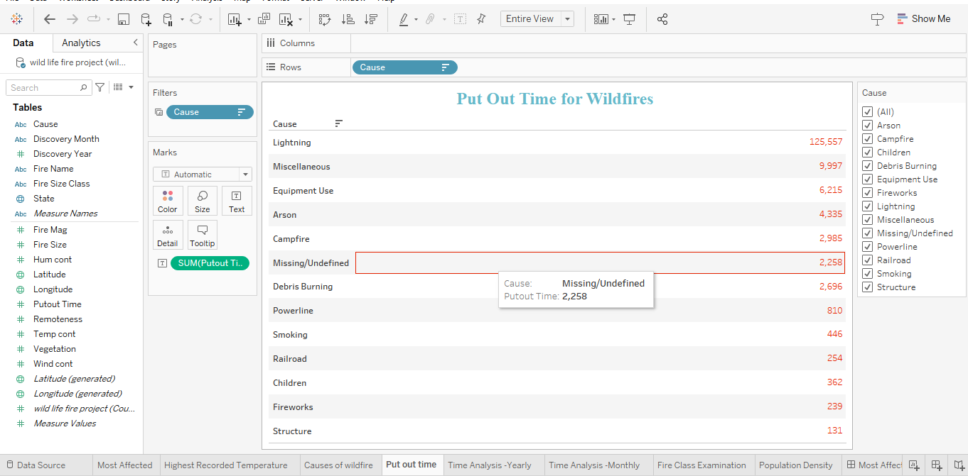
4. Title of Chart: Time of the wildfire extinguishment
Explanation:
Examine the reasons behind wildfires and the amount of time needed to put them out. The table graph lists all of the wildfire causes and shows the time it took to put out each one in descending order for analysis.
Results:
Lightning strikes require the longest time to extinguish, while factors such as buildings, pyrotechnics, and kid-started fires require the least time.

Slide 11
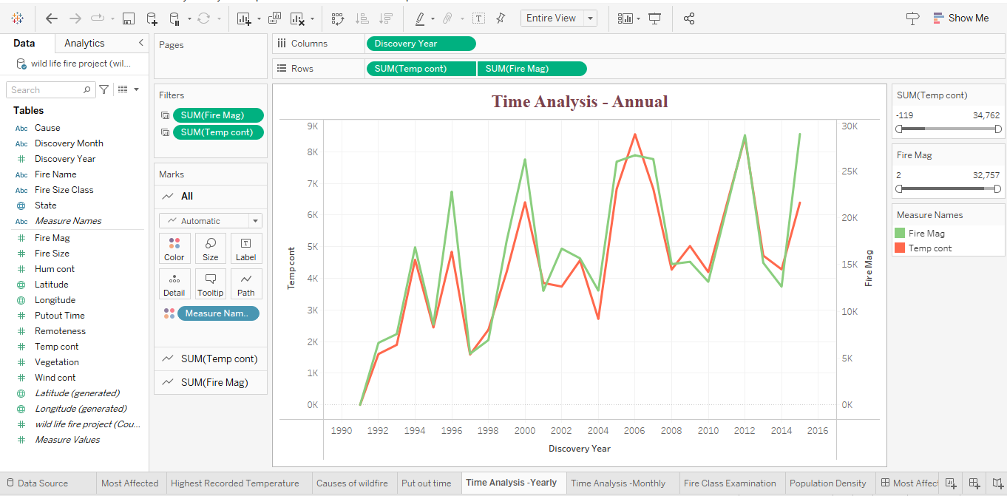
5. Title of Chart: Time Analysis - Annual
Explanation:
The project involves examining data on temperatures and the size of fires from 1990 to 2015. By using a dual-axis chart that combines a bar graph and a line graph, we'll be able to track changes over time. The bar graph will show the number of temperature measurements, while the line graph will display the size of fires for each year. This way, we can analyze the relationship between temperature and wildfires over 25 years.
Results:
The highest recorded temperature counts were in 2006 and 2011. 2011 was also the year with the highest fire magnitude ever recorded. Upon conducting intriguing research, we find that although 2006 saw the highest temperature, it was not the year with the largest fire magnitude.

Slide 12
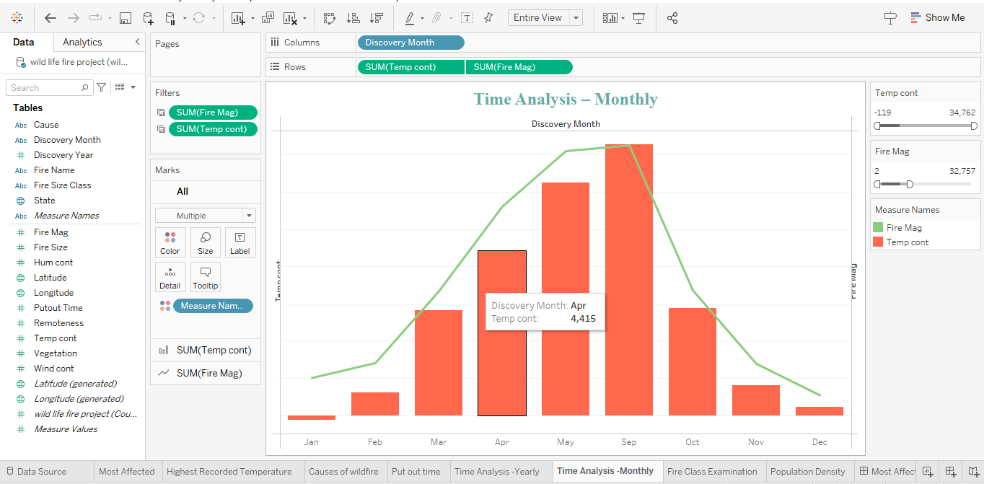
6. Title of Chart: Time Analysis – Monthly
Explanation:
Examining monthly time series to determine the months with the highest number of wildfires reported in a given year. We create a bar graph and line chart to illustrate the analysis, which we put out over a monthly period and compare to the fire magnitude and temperate count. The line chart shows the fire's magnitude over a period of months, while the bar graph shows the recorded temperature.
Results:
According to the data, the months with the greatest temperatures and fire magnitudes ever recorded were July and June.

Slide 13
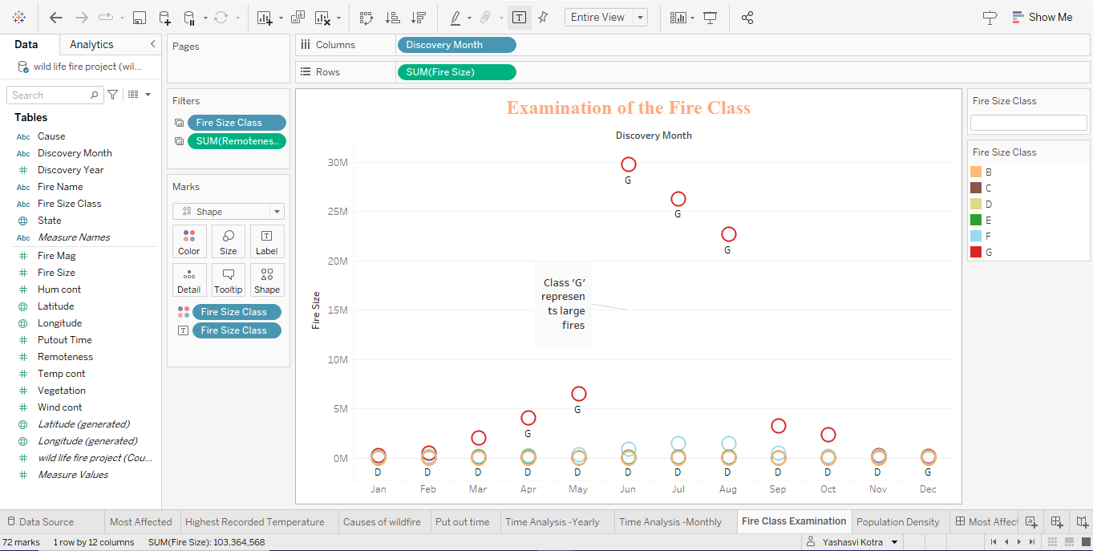
7. Title of Chart: Examination of the Fire Class
Explanation:
Investigations into fire size classes were placed throughout every month. We utilized a stacked bar graph to illustrate the goal, showing various colored fire classifications over the course of each month.
Results:
Throughout the course of several months, fire size class "G" has been found to have the greatest occurrence size class; class "F" comes in second.

Slide 14
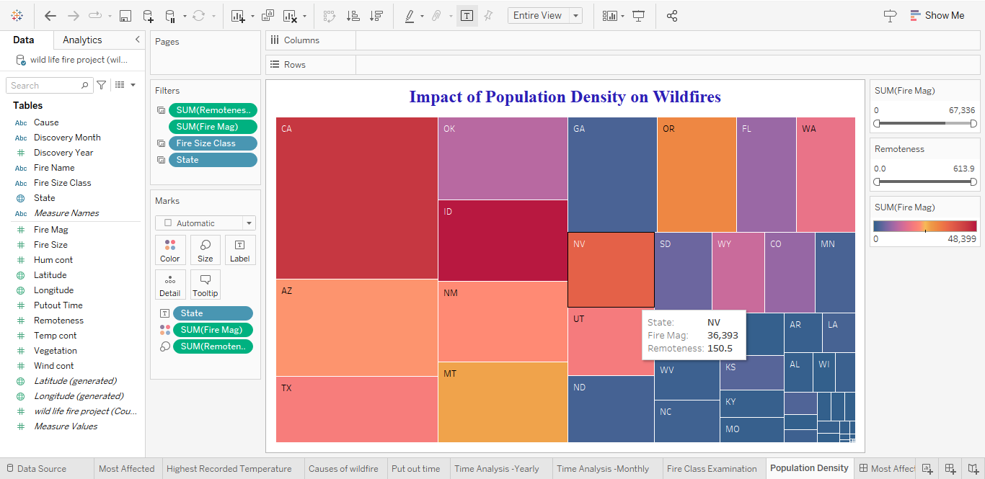
8. Title of Chart: Impact of Population Density on Wildfires
Explanation:
The Aim is to find out if there's a link between how much wildfires affect an area and how many people live there. To show this, we're using tree maps. In these maps, the color shows the intensity of the fires in each state, with green for less intense fires and orange for more intense ones. The size of each section in the treemap shows how remote the area is: bigger sizes mean the area is more remote, which usually means fewer people live there.
Results:
It is clear from an observation that California is the state with the greatest degree of distance relative to population. States with higher remoteness levels include Arizona and Arkansas. There exists a correlation between the states with the lowest population density and the biggest magnitude of fire. However, the states with the biggest population density and least amount of remoteness, such as Colorado, Nevada, and Kansas, experience smaller fires.

Slide 15
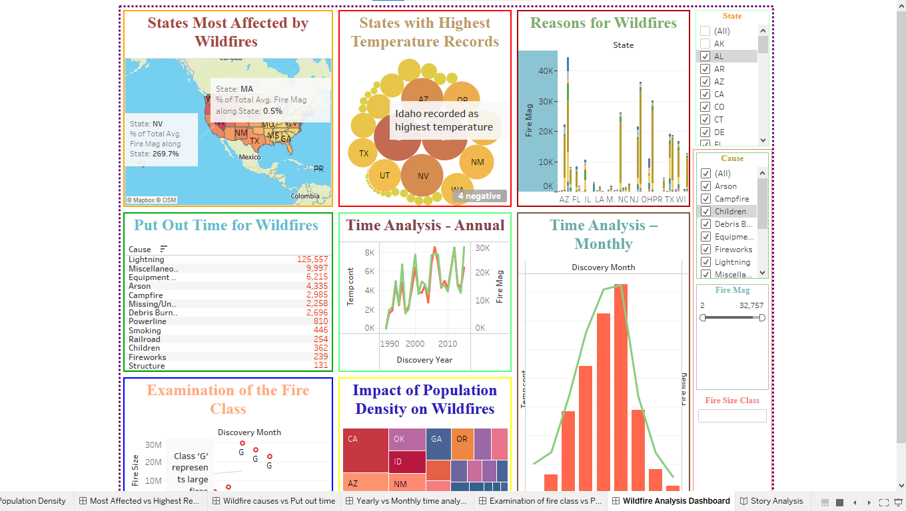
Wildfire Analysis Dashboard:
Comprehensive Evaluation:
Cohesion: The dashboard provides a holistic view by merging multiple data types that are necessary to understand wildfires.
Usability: This interactive feature is a helpful analytical tool since it allows users to dig deeply into specific states, causes, or time periods within the data.
Design: The dashboard is easy to view thanks to its simple, uncomplicated layout. The color palette seems to be deliberately chosen to communicate the type and seriousness of the data.
Data Insights: The dashboard may include information on trends such as the relationship between high temperatures and the frequency or intensity of wildfires, the success of suppression operations across different regions, and the frequency of wildfires in the connection to specific seasons.

Slide 16
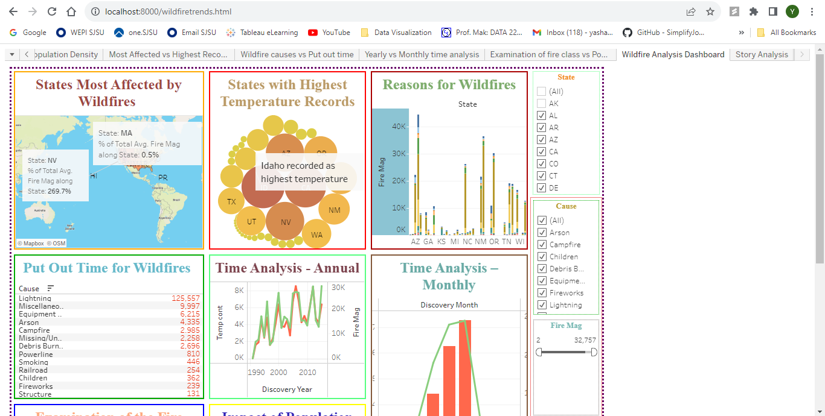
Built the Term Project Dashboard using JavaScript API to combine D3.js
Webpage link : http://localhost:8000/wildfiretrends.html

Slide 17
Synopsis:
The report's insights about the incidence of wildfires in the United States over a period of years highlight key trends and highlight the need for wildfire mitigation. Creating and implementing plans that prevent wildfires and limit damage is one way to achieve this. We have discovered important results from this thorough analysis of historical data and pertinent variables, including the most affected states, the highest temperature ever recorded in a state, the primary causes, such as lightning, and a time series analysis that revealed July to be the month with the highest frequency of occurrence. To establish a correlation, we can look at the fact that July is the lightning month and that lightning is typically the leading cause of wildfires. Our results also offer crucial proof of the relationship between population and wildfire danger: isolated locations often have higher wildfire risk than inhabited ones.

Slide 18
Conclusion:
To sum up, the balance between the environment and humans is at risk because of wildfires. In my research, I've taken steps to raise awareness and tackle the specific challenges that come with wildfires. By applying what I've learned, I can help create a safer and more robust future against the risk of wildfires.

Slide 19
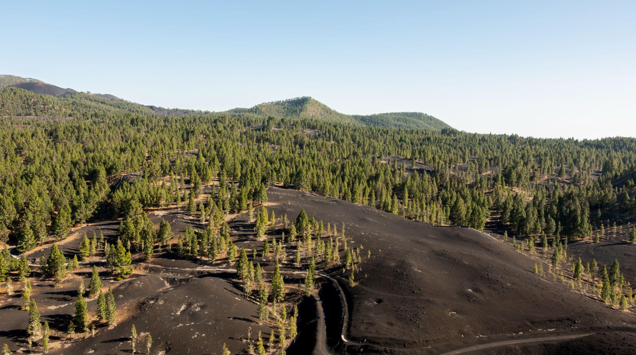
A picture is worth a thousand words

Slide 20
THANK YOU!

